Slide 1
Project 2: Building Materials Visual Dictionary
Megan Shugrue
CON 161: Materials and Methods of Construction
Spring 2020
Professor LoPiccolo

Slide 2
INDEX
CMU - Split Faced
CMU - Ribbed Faced
Stone: Random Ashlar
Metal Flashing
Concrete or Stone Coping
Precast Concrete Lintel
Beam to Column: Shear Connection
Beam to Column: Moment Connection
Shallow Frost-Protected Footing
High Wind Connector
Joist Hanger
Housewrap (Weather-Resistant Barrier)
Vapor Retarder
Moisture-Resistant Drywall
Brick: Common Bond with a Weep Hole

Slide 3
Shallow Frost-Protected Footing
The FPSF system comprises a rigid-foam expanded polystyrene (EPS) insulation foam placed around the outside of a foundation, which directs heat loss from the building toward the foundation and takes advantage of natural geothermal energy. It is based on the principle that heat loss through a building’s foundation keeps the ground beneath from freezing and heaving by raising the frost depth at the foundation’s perimeter.

Slide 4
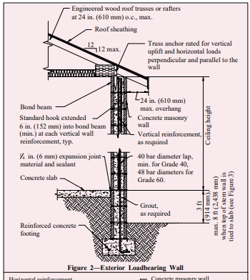
High Wind Connectors:
Loadbearing Wall:
Roof Truss Anchor:
a typical loadbearing wall with a floating floor slab. Vertical reinforcement should be placed in the center of the concrete masonry cores to adequately resist both positive and negative wind pressures. Bond beam depth and minimum horizontal reinforcement varies with design wind velocity, ceiling height, roof truss span and spacing of vertical wall reinforcement.
a typical roof truss anchor cast into the bond beam of a concrete masonry bearing wall. The required anchor load capacity depends on the design wind speed as well as the roof truss span. In addition to being rated for uplift, the anchor must be rated for horizontal forces parallel to the wall (in-plane) and perpendicular to the wall (out-of-plane).

Slide 5
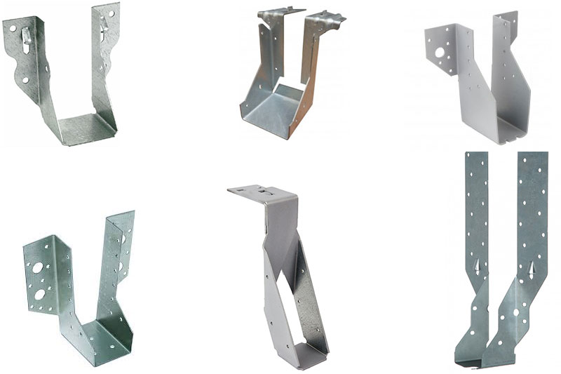
Joist Hanger
A metal "U" shaped item used to support the end of a floor joist and attached with hardened nails to another bearing joist or beam.

Slide 6
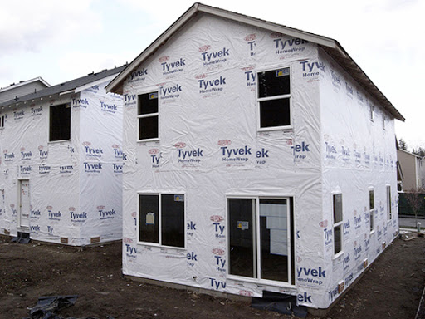
Housewrap (Weather Resistant Barrier)
a fabric, paper, or board material that covers the exterior sheathing of house walls to protect the wall framing
It also permits the transfer of water vapor to the outside of the protected structure because water vapor can pass through it

Slide 7
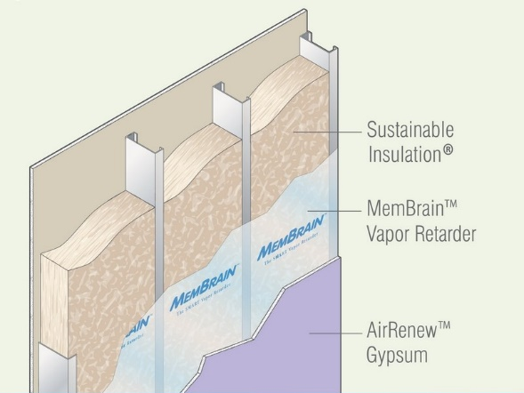
Vapor Retarder
Moisture control through limiting water vapor movement in commercial buildings is essential. A vapor retarder helps prevent water vapor from moving into building assemblies, like walls, where it can condense into liquid water within the structure. Liquid water can accumulate inside exterior walls and in roof and crawl spaces. If enough water is present, rot and decay can cause significant damage.
a material or system that adequately retards the transmission of water vapor under specific conditions.

Slide 8
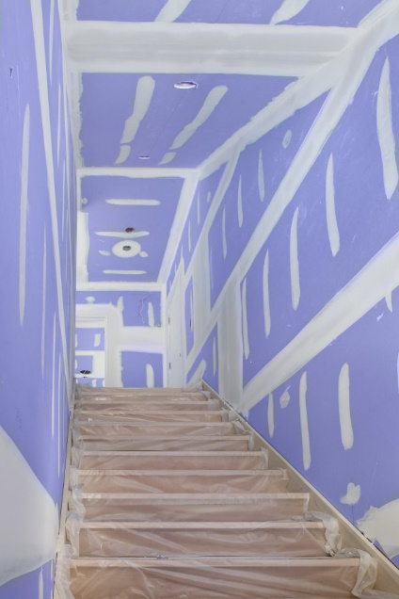
Moisture Resistant Drywall
It's made of compressed gypsum core like regular drywall, but it offers a thicker coating of paper that's covered with wax for water resistance.

Slide 9
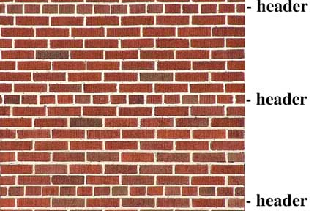
Brick: Common Bond with a Weep Hole
A weep, a weep hole, or a weep-brick is a small opening that allows water to drain from within an assembly. Weeps are located at the bottom of the object to allow for drainage; the weep hole must be sized adequately to overcome surface tension.

Slide 10
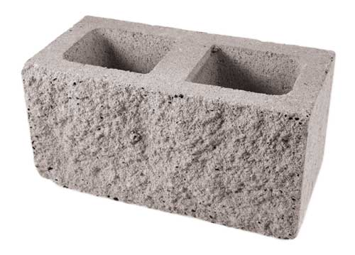
CMU: Split Faced
A concrete building unit which appears to have been hand-chiseled (or “split”) to give it a very textured look.

Slide 11
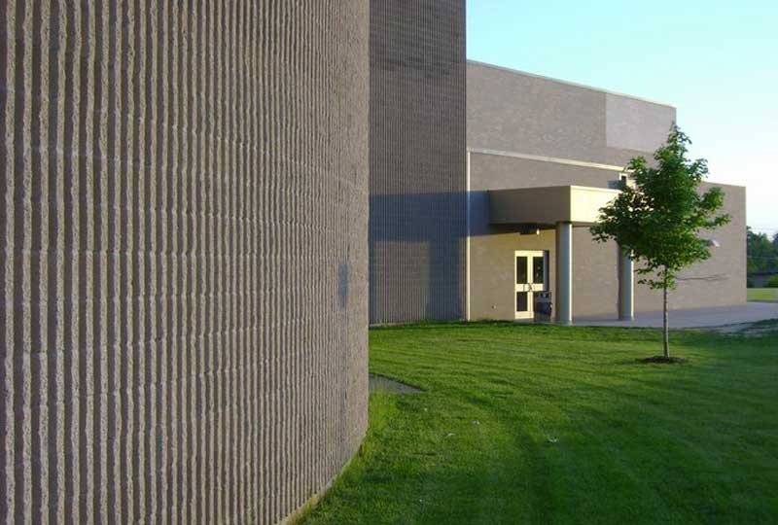
CMU: Ribbed Faced
typically have 4, 6, or 8 vertical ribs which align to form
continuous vertical elements in the finished wall. The ribs are molded into the unit using a special mold. The ribs may have either a rectangular or circular profile and may be either smooth or split for added texture.

Slide 12
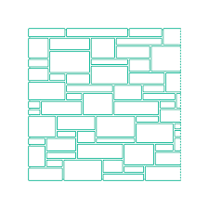
Stone: Random Ashlar
is formed using finely dressed stones of same size, shape, and texture laid together in cement or lime mortar of equal size joints at right angles to each other.

Slide 13
Metal Flashing
are used on exterior walls but primarily on roofs. They can be made from many materials, including tin, copper, galvanized metal, plastic, wood and lead.
is used to transition from the roofing material to something that is not a roof.

Slide 14
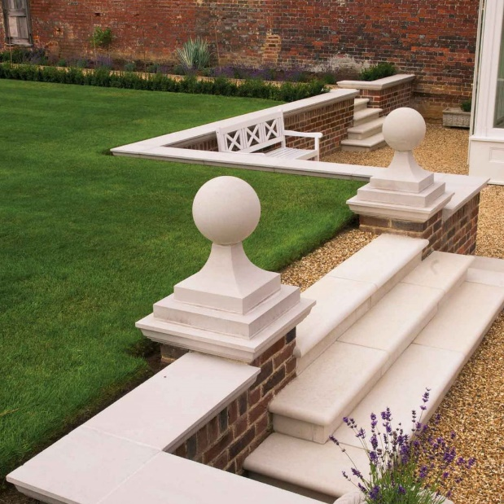
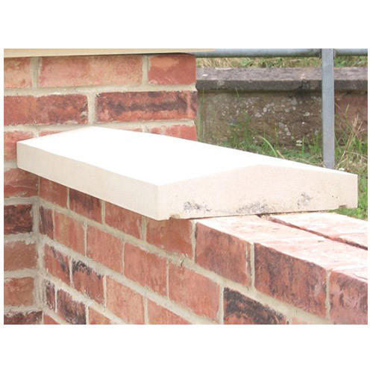
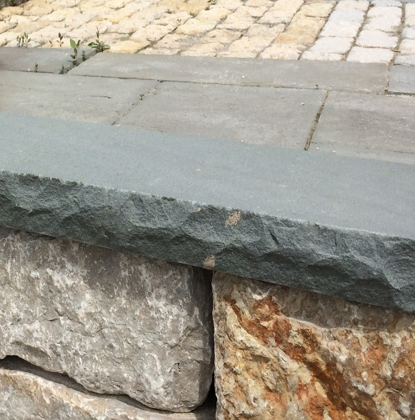
Concrete or Stone Coping
A coping may consist of stone (capstone), or, concrete or cast stone. In all cases it should be weathered (have a slanted or curved top surface) to throw off the water.

Slide 15
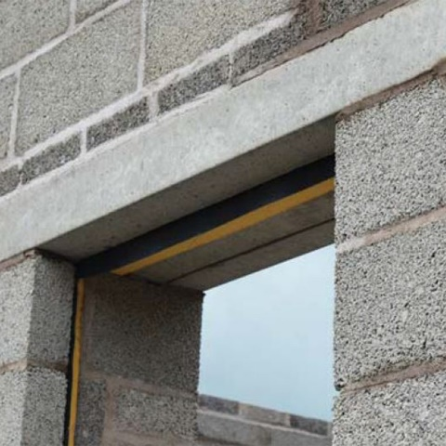
Precast Concrete Lintel
Loads above openings are carried by horizontal structural members

Slide 16
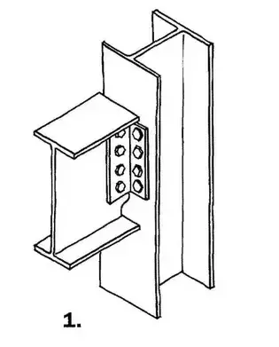
Beam to Column: Shear Connection
A beam bolted to a column. It is a shear only connection because the beam flanges are not rigidly connected to the column.
A shear connection keeps something from sliding back and forth.

Slide 17
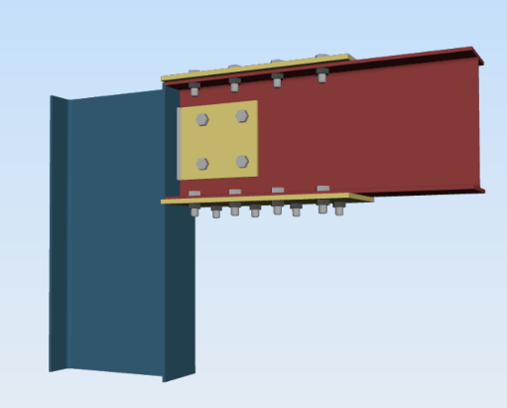
Beam to Column: Moment Connection
A welded beam to the column. The beam flange welds transmit full flange strength to the column. The shear tab, welded to the column, and bolted to the beam web, supports the beam until it is welded and offers permanent shear resistance.
A moment connection keeps something from turning in a circle.

